Slide 1
Project : Strike 5
Cao Minh Duc. Dao Ngoc Nam.

Slide 2
Content
About game Strike 5
Analysis problem
Test program
Summary

Slide 3
About game Strike 5
Strike 5 is a computer game that will help players sharpen their brains and improve their concentration.

Slide 4
Analysis problem
It is a two-player game.
The game’s location is a form containing a 15x15 grid.
A player can click only one cell at a time.
To win the game, a player needs to color five consecutive cells in the color assigned to him or her, such that all the five cells are in the same row, column, or diagonal.

Slide 5
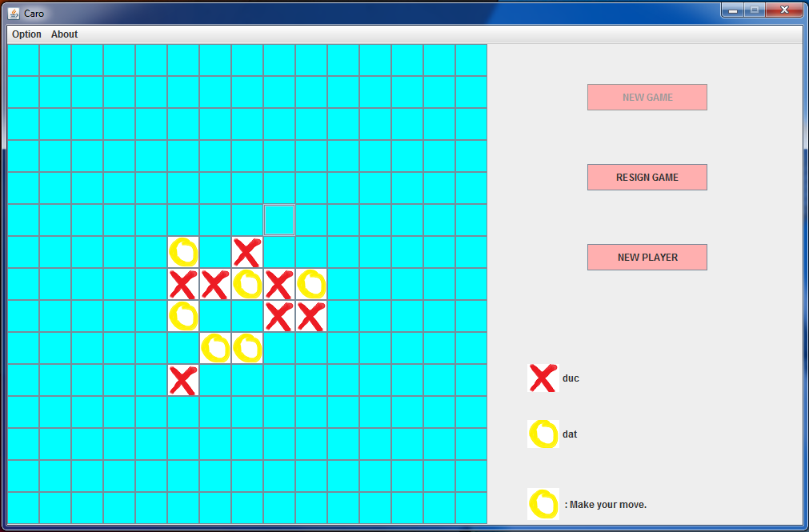
Test program
Interface of program :

Slide 6
Summary
Somethings need to continued develop :
Have sound when playing game.
Saved infomations of Player.
Display top of Players.

Slide 7
Thanks for listening

